Slide 1
Infographics Toolkit Prototype
Group SAS2
Ankita Pise
Jesseca Taylor
Nitish Pandey
Sharan Gopalan
Yashwanth Nallabothu

Slide 2
Supported Use Cases

Slide 3
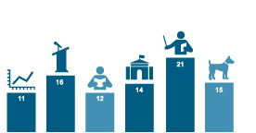
Connect Images to Chart

Slide 4
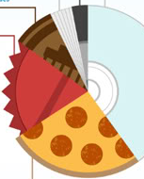
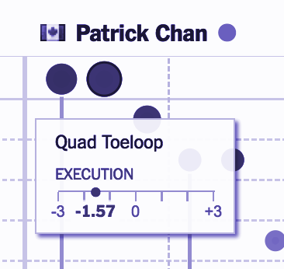
Replace Pie Slices with Images
Customized Images, Text, & Visualizations Tooltips

Slide 5
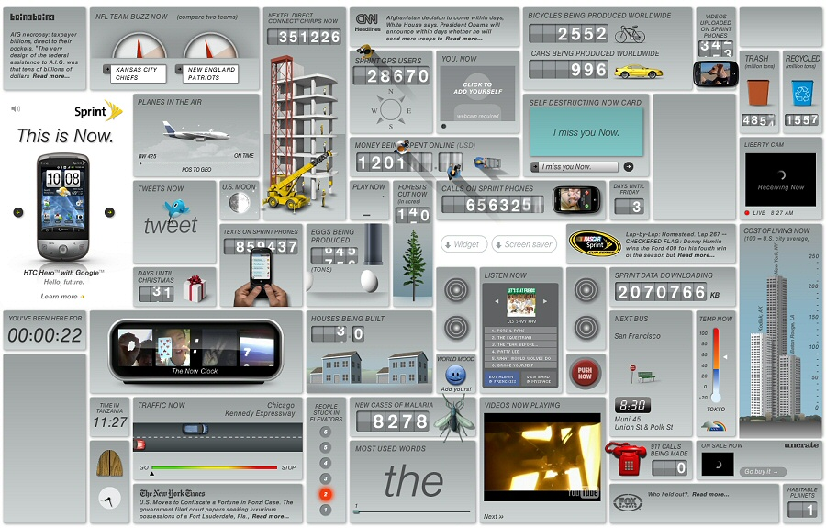
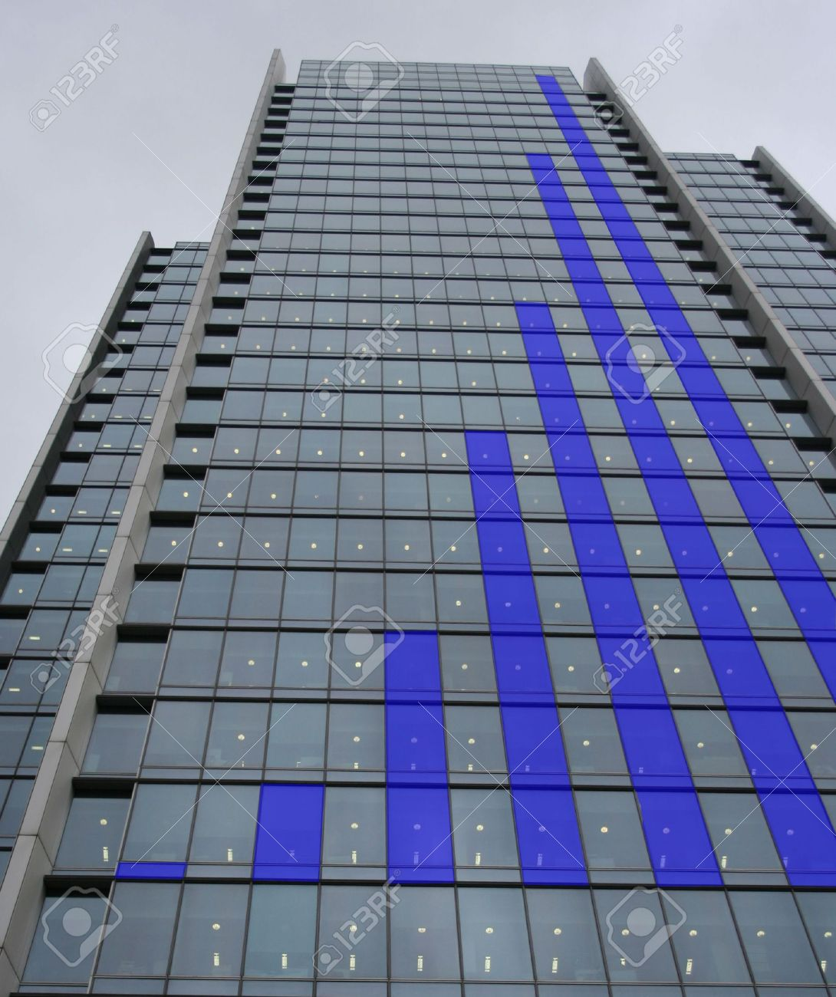
Attach Images to entire visualization
Use overlayed & masked images for decoration

Slide 6
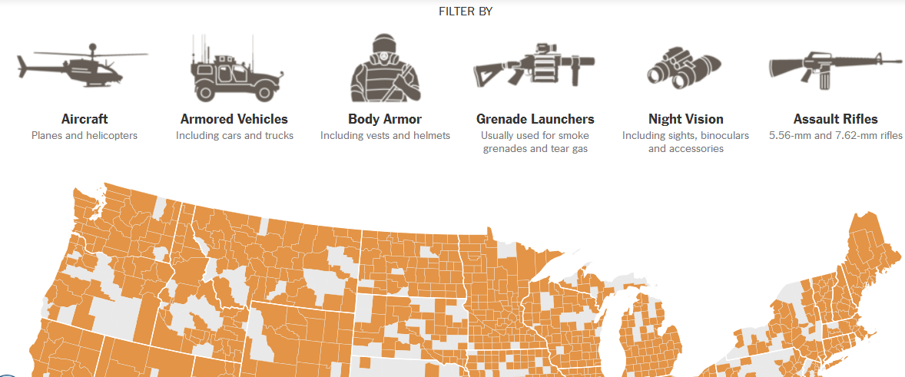
Images & Custom Content in Filtering Controls

Slide 7
Experiential Goals
Usefulness
Ease-of-use
Pleasantness
Attractiveness
Originality
Innovative

Slide 8
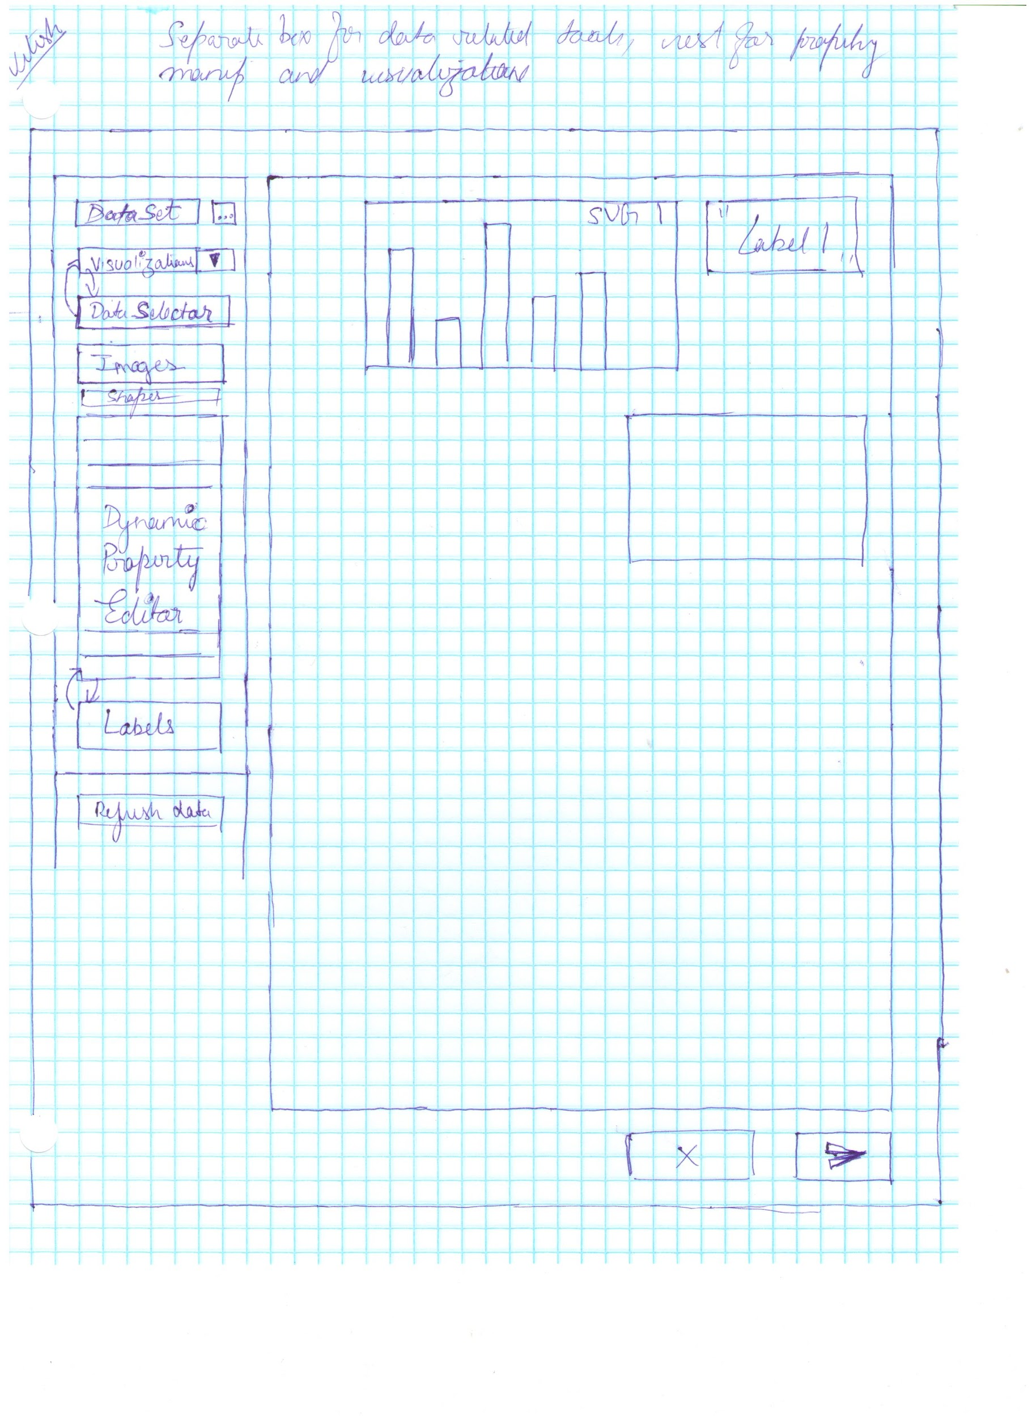
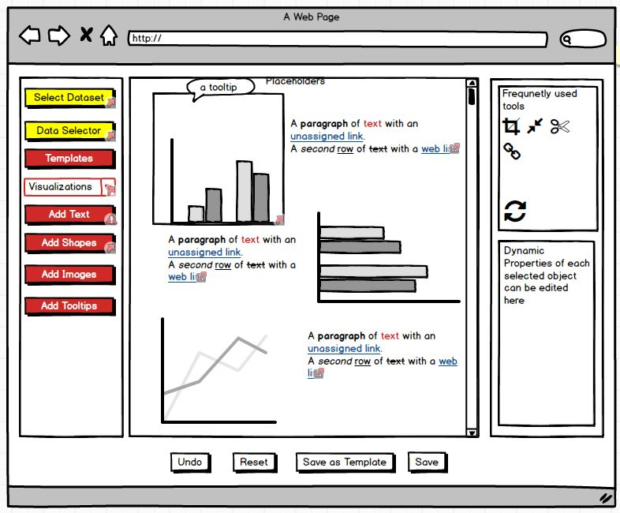
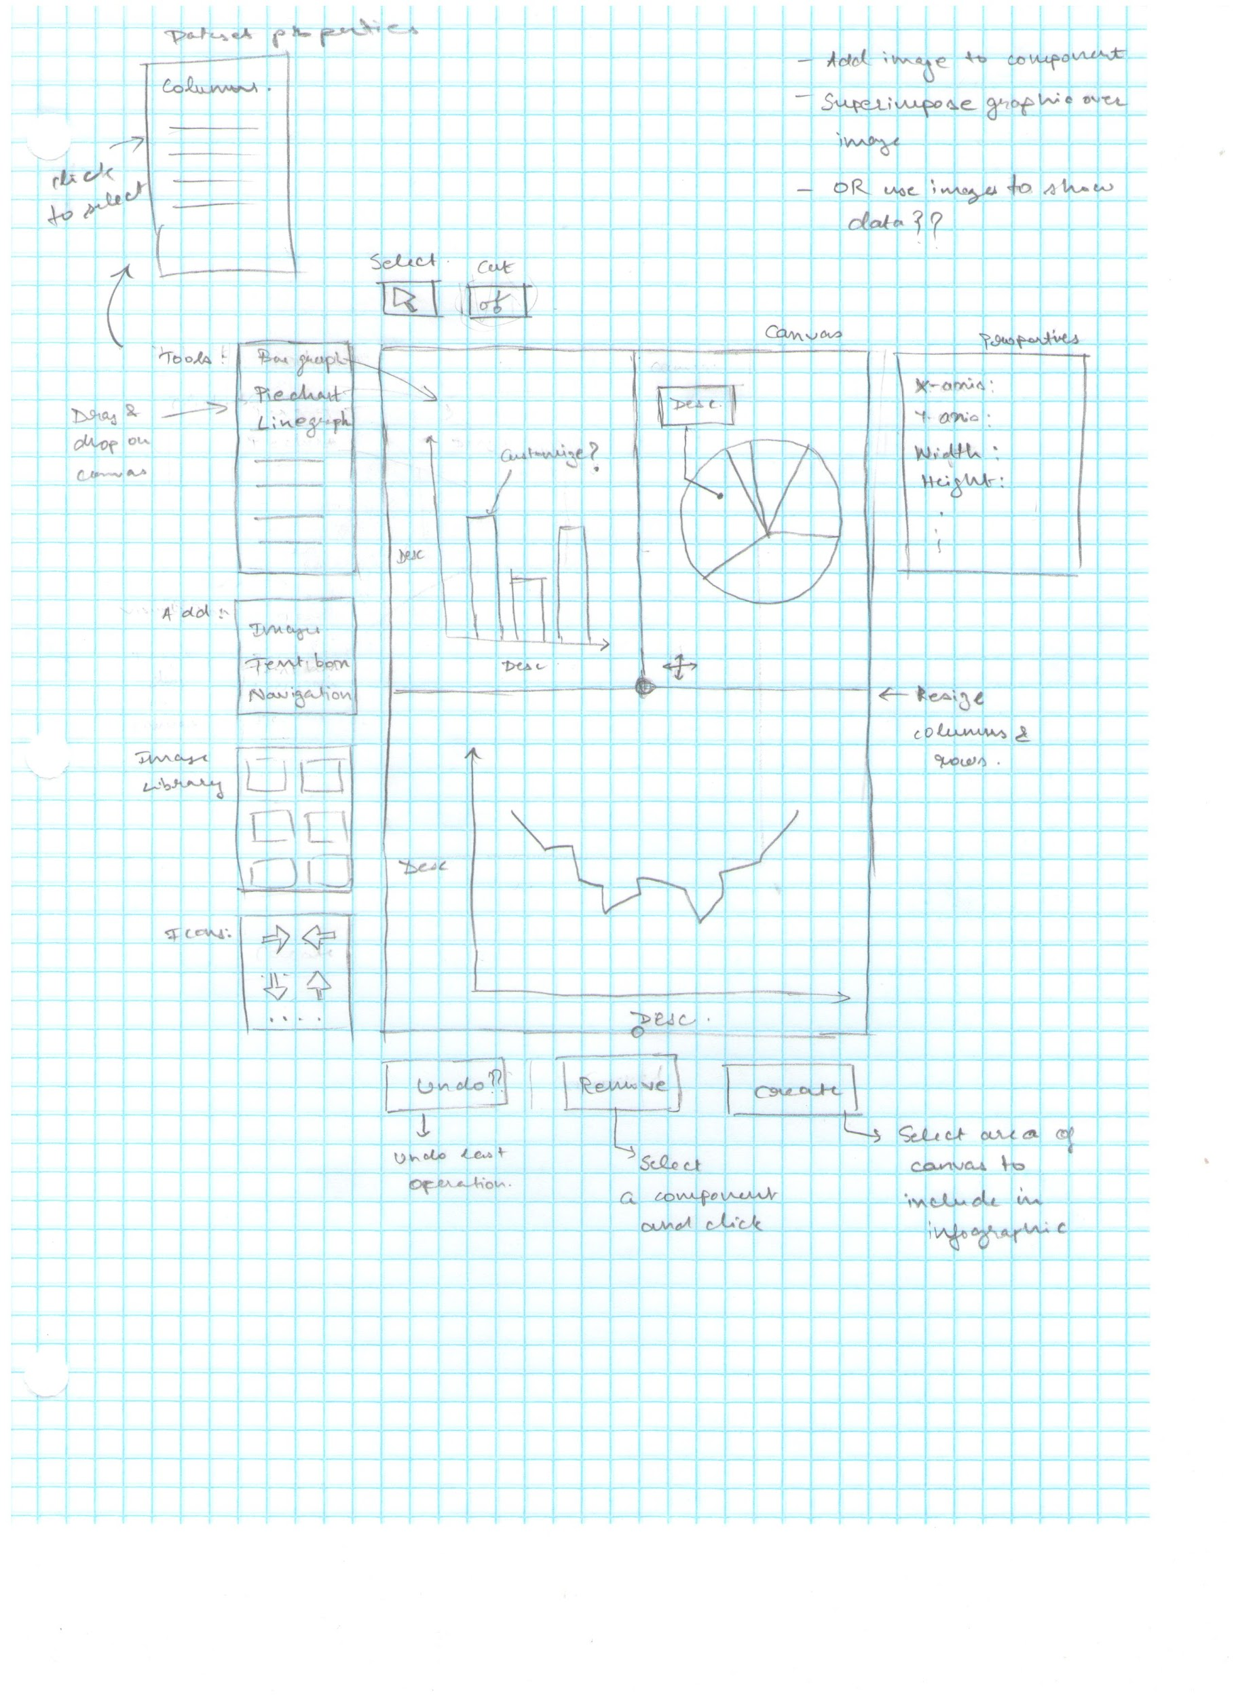
Early Work

Slide 9
Formative Evaluation Results
Positives: Simple and Clean Layout
Needs Improvement: Tool Language

Slide 10
Final Low-Fidelity Prototype Demo
Link to demo video

Slide 11
High Fidelity Prototype Demo
Link to demo video

Slide 12
Evaluation Results
3 participants, varying in experience
Task-based evaluation
Between tasks
Single Ease Use (SEQ) question
Explanation of SEQ rating
Post-scenario
System Usability Scale (SUS)

Slide 13
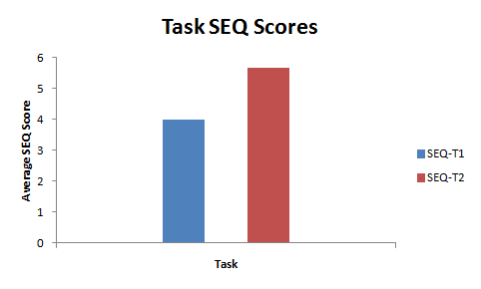
Evaluation Results
Positives
“Background was simple enough from add background button as well as text from add text button. Selecting certain columns from dataset was simple using dual box with add/remove arrows.”

Slide 14
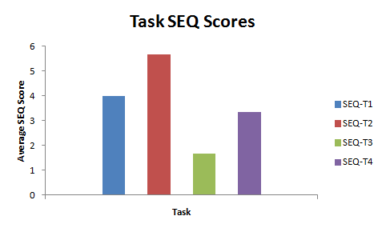
Evaluation Results
Needs Improvement
Restricted functionality with Balsamiq
Lack of transitions in Balsamiq
Solution
High fidelity prototype
More functionality
Direct manipulation

Slide 15
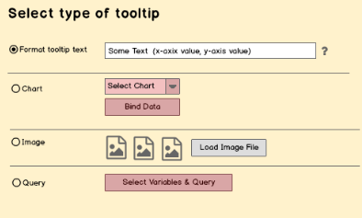

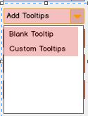
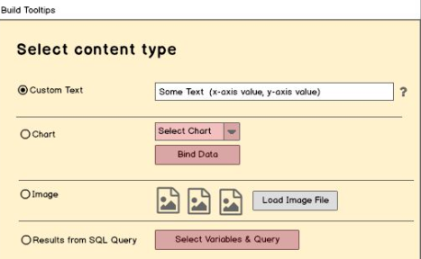
Improvements

Slide 16

Conclusion
Insights Gained
More design iterations
Fidelity of prototype matters

